Slide 1
DELTA MODULATION

Slide 2
WHY DELTA MODULATION IS USED ?
PCM- converts message signal directly into a sequence of a binary coded pulse.
transmits all bits which are used to code a sample.
Hence sampling rate and transmission channel BW are quite large in PCM
To overcome this, we go for DM.

Slide 3
Working principle of Delta Modulation
a comparison between present and previously sampled value is performed
the difference of which decides the increment or decrement in the transmitted values.
either we get difference having a +ve or -ve polarity .
If the difference polarity is +ve, then the step of the signal denoted by Δ is increased by 1.
when difference polarity is negative, then step of the signal is decreased i.e., reduction in Δ.

Slide 4
When +Δ is noticed i.e., increase in step size, then 1 is transmitted.
–Δ : decrease in step size, 0 is transmitted.
The step size is kept fixed.
Hence, allowing only a single binary bit to get transmitted for each sample.

Slide 5
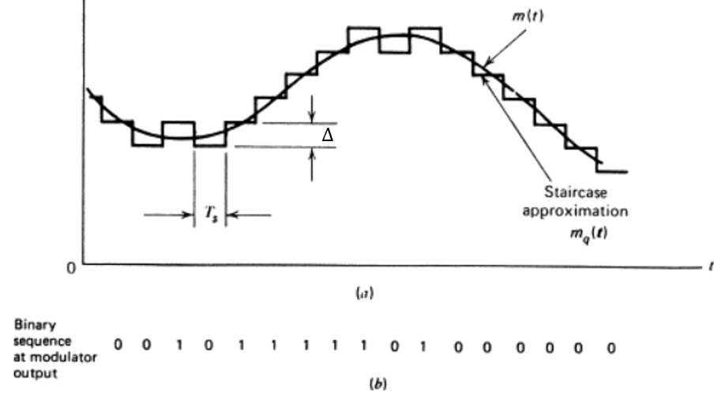
Delta Modulation Waveform

Slide 6

Mathematical Expressions
The error between the sampled value of x(t) and last approximated sample is given as:
Where e( nT_{s}) = error at present sample
x(nT_{s}) = sampled signal of x(t)
$\hat{x}(n\text{T}\text{s})$ = last sample approx. of staircase w/f

Slide 7


If we assume u(nT_{s}) as the present sample approximation of staircase output, then
Let us define a quantity b(nT_{s}) in such a way that,
This means that depending on the sign of error e(nT_{s}) , the sign of step size Δ is decided. In other words we can write

Slide 8

if b(nT_{s}) = +Δ, then a binary ‘1’ is transmitted
if b(nT_{s}) = -Δ, then a binary ‘0’ is transmitted
Here T_{s} = sampling interval.

Slide 9
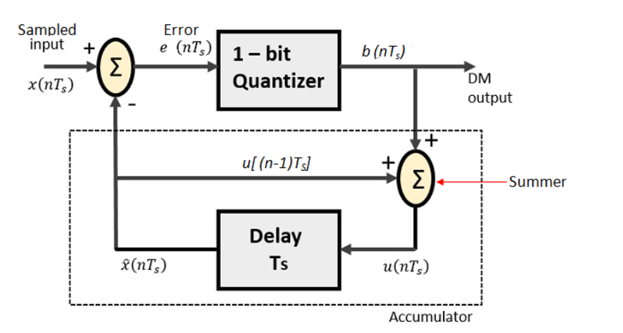
Generation of delta modulated signal
Delta Modulation Transmitter

Slide 10

It consists of a 1-bit quantizer and a delay circuit along with two summer circuits.
The summer in the accumulator adds quantizer output (±Δ) with the previous sample approximation .
This gives present sample approximation. i.e.,

Slide 11
The previous sample approximation u[(n-1)T_{s}] is restored by delaying one sample period T_{s} .
The samples input signal x(nT_{s} ) and staircase approximated signal xˆ(nT_{s} ) are subtracted to get error signal e(nT_{s} ).
Thus, depending on the sign of e(nT_{s}), one bit quantizer generates an output of +Δ or -Δ .
If the step size is +Δ, then binary ‘1’ is transmitted and if it is -Δ, then binary ‘0’ is transmitted .

Slide 12
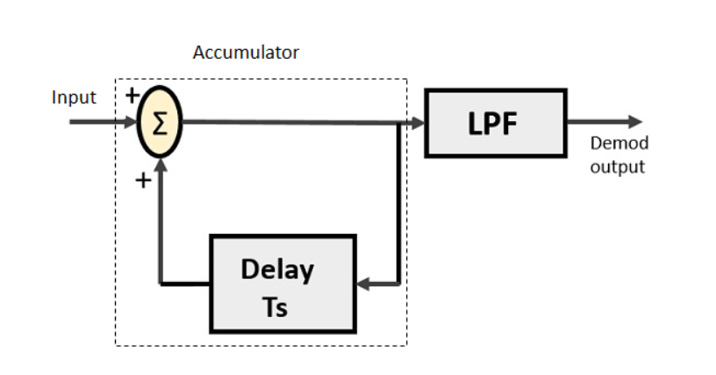
Delta Modulation Receiver

Slide 13
it comprises of a LPF, a summer and a delay circuit.
The predictor circuit is eliminated here and hence no assumed input is given to the demodulator.
The accumulator generates the staircase approximated signal output and is delayed by one sampling period T_{s}.
It is then added to the input signal.
If the input is binary ‘1’ then it adds +Δ step to the previous output (which is delayed).

Slide 14
If the input is binary ‘0’ then one step ‘Δ’ is subtracted from the delayed signal.
Also, the low pass filter smoothens the staircase signal to reconstruct the original message signal x(t) .

Slide 15
Advantages of Delta Modulation
Due to transmission of only 1 bit per sample, it permits low transmission channel bandwidth as well as signaling rate compared to PCM.
ADC is not required. Thus permits easy generation and detection. So txr & rxr implementation is simple compared to PCM.

Slide 16
Drawbacks of Delta Modulation
Delta modulation is subject to two types of quantization errors:
Slope overload distortion
Granular or idle noise

Slide 17
Applications of delta modulation
It is widely used in
radio communication devices
digital voice storage
voice information transmission
where signal quality is less important.

Slide 18
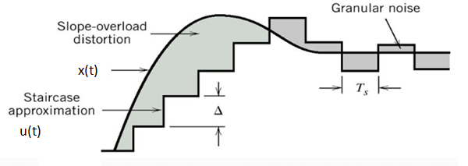
Slope overload distortion
This distortion arises because of large dynamic range of the input signal.
Fig: Quantization Errors in Delta Modulation

Slide 19
We can observe from fig. , the rate of rise of input signal x(t) is so high that the staircase signal can not approximate it, the step size ‘Δ’ becomes too small for staircase signal u(t) to follow the step segment of x(t).
Hence, there is a large error between the staircase approximated signal and the original input signal x(t).
This error or noise is known as slope overload distortion .
To reduce this error, the step size must be increased when slope of signal x(t) is high.

Slide 20
Since the step size of delta modulator remains fixed, its max or min slopes occur along straight lines.
Therefore this modr is also known as linear delta modulator (LDM).

Slide 21
In order for the sequence of quantized samples x_{q}(nT_{s}) to increase as fast as the sequence of input samples x(nT_{s}) in a region of maximum slope of x(t), we require that the condition
$\frac{∆}{\text{T}\text{s}}$ $≥\max{|\frac{d}{dt}x\left(t\right)|}$
be satisfied.
Otherwise, we find that the step size is too small for the staircase approximation x_{q}(t) to follow a steep segment of the original message signal with the result x_{q}(t) that falls behind x(t) as illustrated in Fig. This condition is called slope overload.

Slide 22
Granular or Idle Noise
Granular or Idle noise occurs when the step size is too large compared to small variation in the input signal.
This means that for very small variations in the input signal, the staircase signal is changed by large amount (Δ) because of large step size.

Slide 23
Fig. shows that when the input signal is almost flat , the staircase signal u(t) keeps on oscillating by ±Δ around the signal.
The error between the input and approximated signal is called granular noise.
The solution to this problem is to make the step size small .

Slide 24
Solution
In order to overcome the quantization errors due to slope overload and granular noise, the step size (Δ) is made adaptive to variations in the input signal x(t).
A large step size is required to accommodate wide dynamic range of the i/p s/g --- to reduce slope overload distortion
Small steps are required to reduce granular noise.

Slide 25
Particularly in the steep segment of the signal x(t), the step size is increased. And the step is decreased when the input is varying slowly.
This method is known as Adaptive Delta Modulation (ADM).
The step size is made adaptive to variations in the input s/g.

Slide 26
